Slide 1

INTERNET OF THINGS
Chapter 6: Application Protocols for IoT
Dr. Nagegowda K S
Department of Computer Science & Engineering

Slide 2
INTERNET OF THINGS
Agenda
The Transport Layers
IoT Application Transport Methods

Slide 3
INTERNET OF THINGS
The Transport Layer
Transmission Control Protocol(TCP)
User Datagram Protocol(UDP)

Slide 4
INTERNET OF THINGS
IoT Application Transport Methods
Application Layer protocol not present
Supervisory control and data acquisition(SCADA)
Generic web-based protocols
IoT application layer protocols

Slide 5
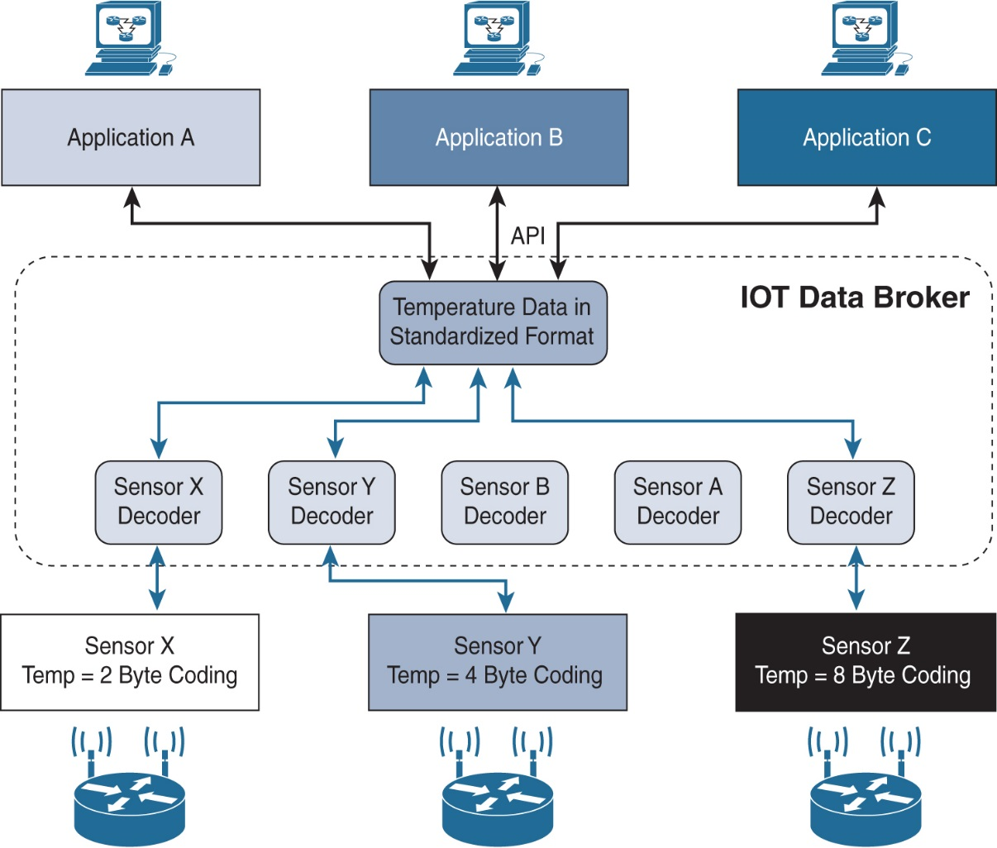
INTERNET OF THINGS
Application Layer protocol not present
Figure - IoT Data Broker

Slide 6
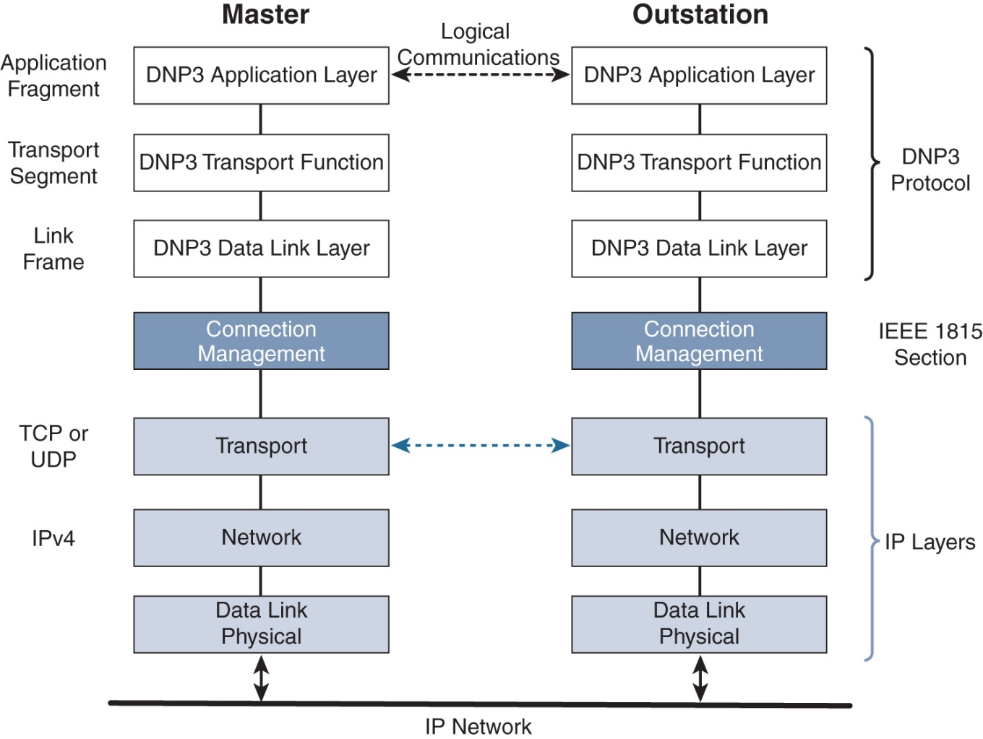
INTERNET OF THINGS
SCADA
Figure - Protocol Stack for Transporting Serial DNP3 SCADA over IP

Slide 7
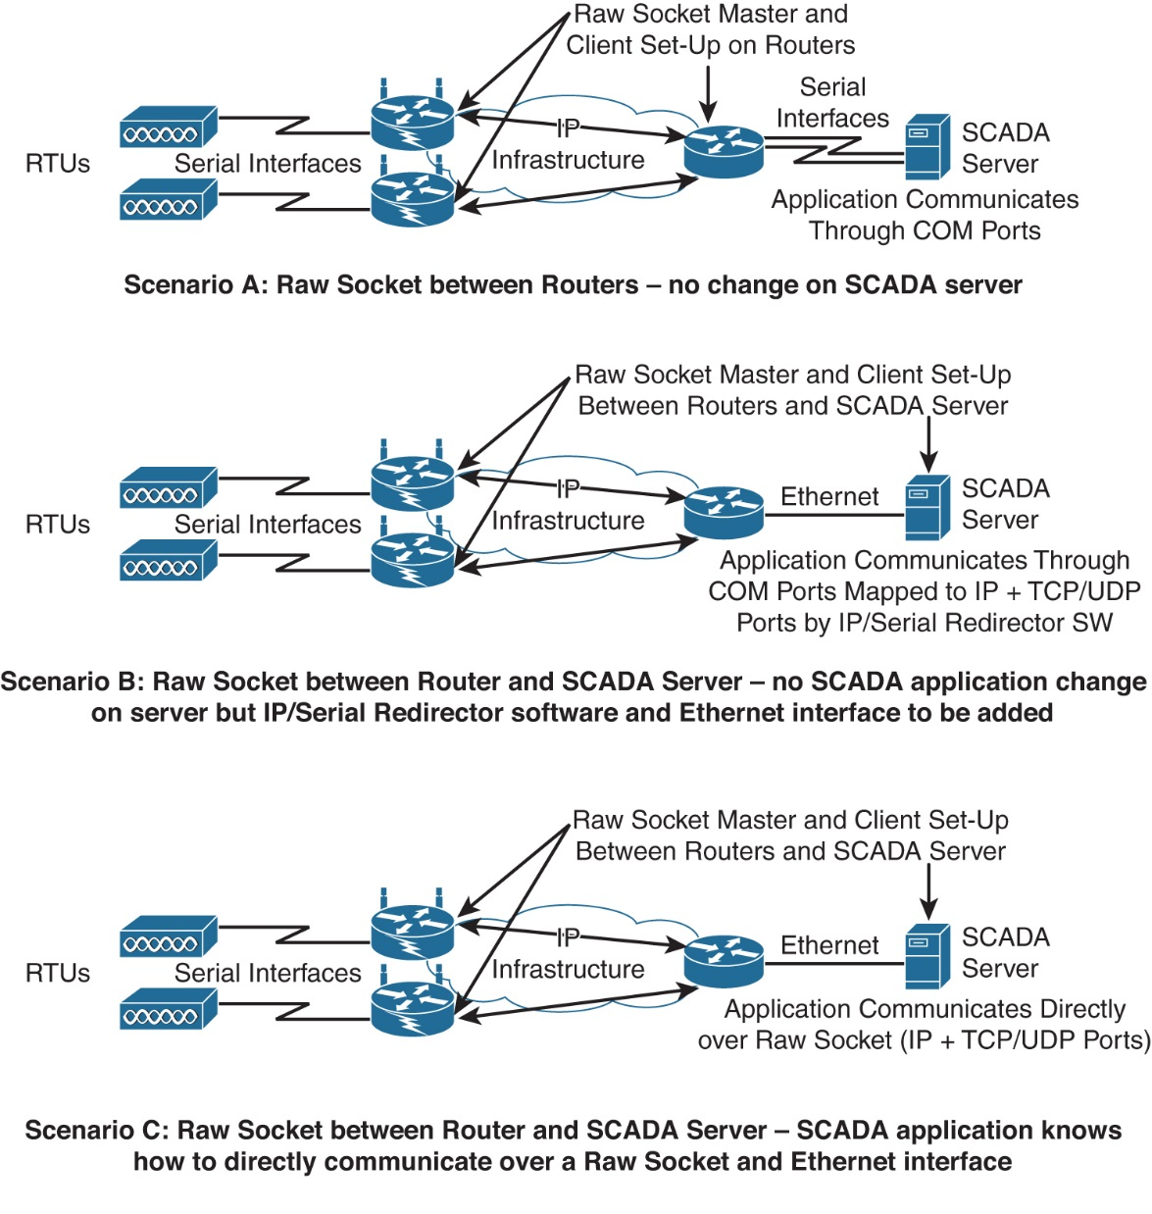
INTERNET OF THINGS
SCADA
Figure - Raw Socket TCP or UDP Scenarios for Legacy Industrial Serial Protocols

Slide 8
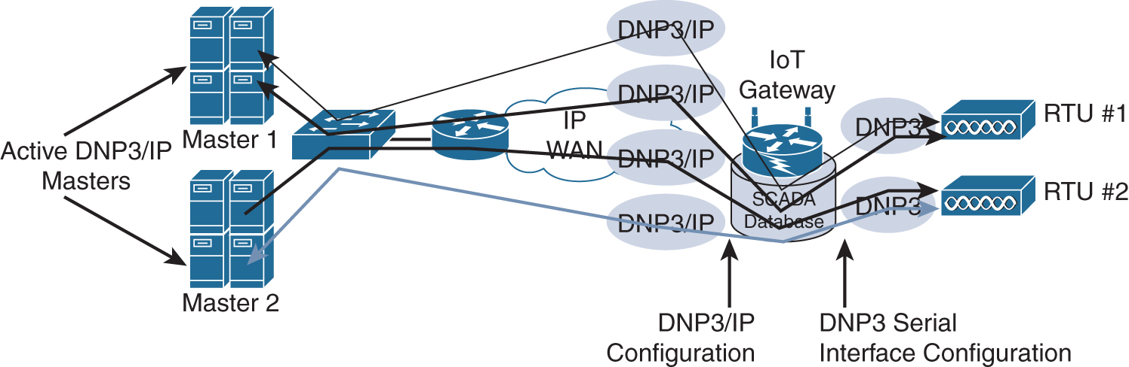
INTERNET OF THINGS
SCADA
Figure - DNP3 Protocol Translation

Slide 9
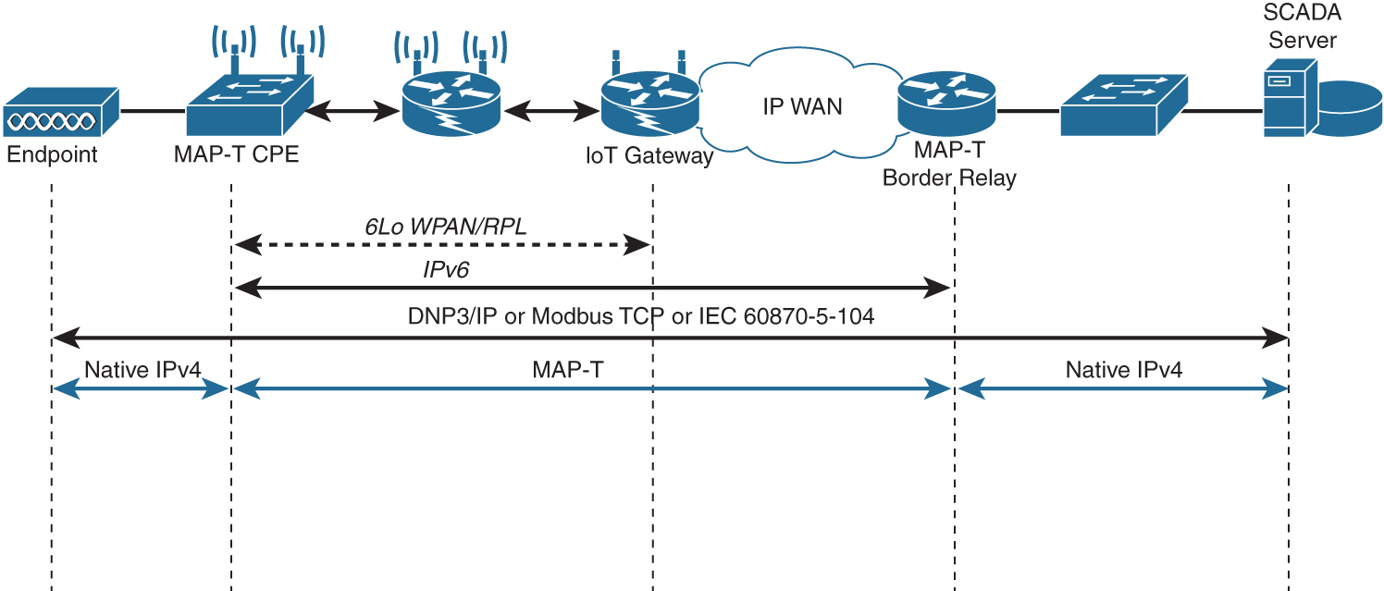
INTERNET OF THINGS
SCADA
Figure - DNP3 Protocol over 6LoWPAN Networks with MAP-T

Slide 10
INTERNET OF THINGS
Generic Web-Based Protocols
HTTP/HTTPS
SMPP(Extensible messaging and Presence Protocol
SOAP(Simple Object Access Protocol)
REST(Representational state transfer)

Slide 11

THANK YOU
Dr. Nagegowda K S
Department of Computer Science & Engineering
nagegowda@pes.edu

